Slide 1
Development of "Triple Halo Coil" for Deep Transcranial Magnetic Stimulation
Group1629
Aashwatth Agarwal
Dylan Jagger Rasmusson
Wentai Wang
Advisor
Dr. Ravi Hadimani

Slide 2
Transcranial Magnetic Stimulation (TMS)
Transcranial magnetic stimulation (TMS) is a neurophysiologic technique that allows for noninvasive stimulation of the outer region of human brain. This method can be used to treat many disorders such as Parkison’s Disease, Depression, and Traumatic Brain Injury.
Food and Drug Administration (FDA) has approved this technology for the treatment of depression using standard coil which is capable of stimulating upper region of the brain.

Slide 3
Problem Statement
Magnitude of magnetic fields decays rapidly as distance from the source increases
Current TMS coils can only stimulate the outer regions of the brain

Slide 4
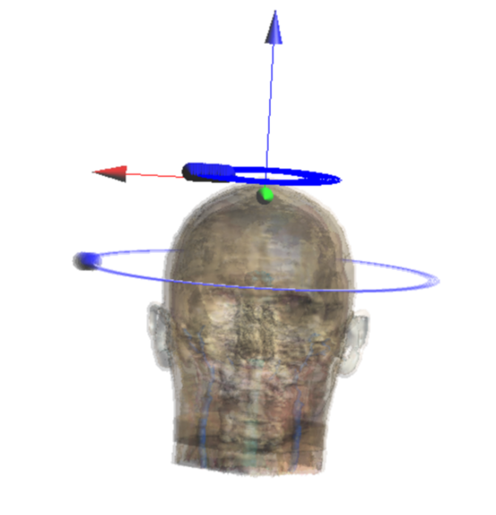
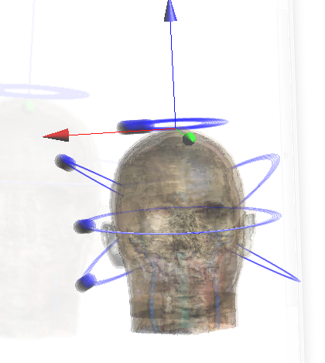
Moving Forward
Halo Coils
Triple Halo Coils

Slide 5
Advantage
Able to stimulate deeper region inside the brain
Can work great in treating depression, Parkison’s, PTSD, etc. which requires stimulation deep within the brain.
Produces much better magnetic field strength as compared to Figure of Eight, and standard halo coil.

Slide 6
Functional Requirement
Achieve maximum stimulation of 150 V/m inside the deep region of the brain
The peak current should not exceed 5000 A
The helmet should be able to move freely as directed
Should be able to control it through computer

Slide 7
Non-functional Requirements
Should be accurate in achieving consistent results
Should be reliable with low decay rate
Should be comfortable when applied over patients
Ensure complete safety of patients.
Should be able to accomodate different head sizes

Slide 8
Potential Risk & Mitigation
Physical Dangers
Coil Temperature not to exceed 50◦C
Avoid excess stimulation to face/scalp
Low focality could lead to neurological damage

Slide 9
Cost Estimate
Device
Magstim Stimulator $20,000
Coils -$200-$400
Case -$5.75/cubic inch material using 3D Printer

Slide 10
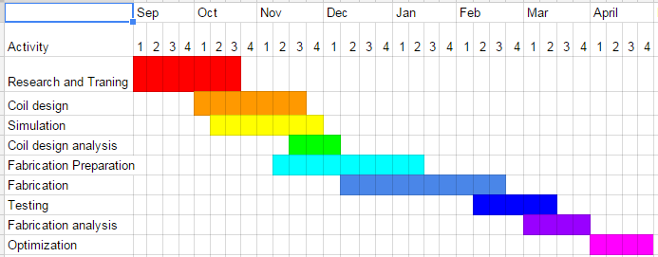
Project Milestones & Schedule

Slide 11
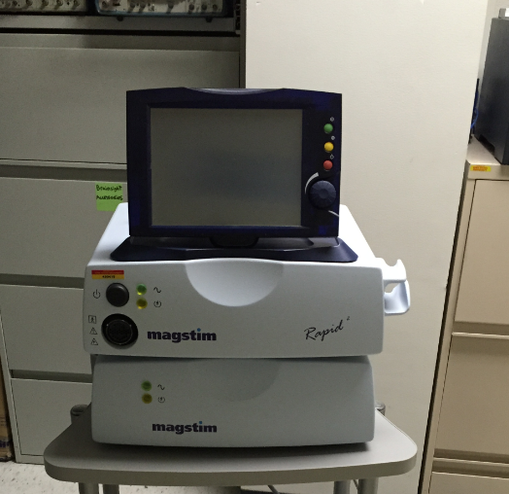
System Design-Stimulator
Magstim Rapid²
System power supply
High current pulse generator (5000 Amps)
Stimulating Coil (4 Tesla)
Pulse Duration (100μs to 1ms)
90% discharge occurs within first 100μs
Time-varying magnetic field induces a current in the tissue
Able to combat psychiatric conditions and evaluate neurological conditions.

Slide 12
Technology Platform Used
SEMCAD X - A full-wave 3D electromagnetic simulation software, offering a novel suite of seamlessly integrated solutions tailored to address a wide variety of engineering challenges across a broad portfolio of simulation, design, and engineering applications.
Sim4file - A revolutionary simulation platform, combining computable human phantoms with the most powerful physics solvers and the most advanced tissue models, for directly analyzing biological real-world phenomena and complex technical devices in a validated biological and anatomical environment.
COMSOL - A finite element analysis, solver and Simulation software / FEA Software package for various physics and engineering applications, especially coupled phenomena, or multiphysics.

Slide 13
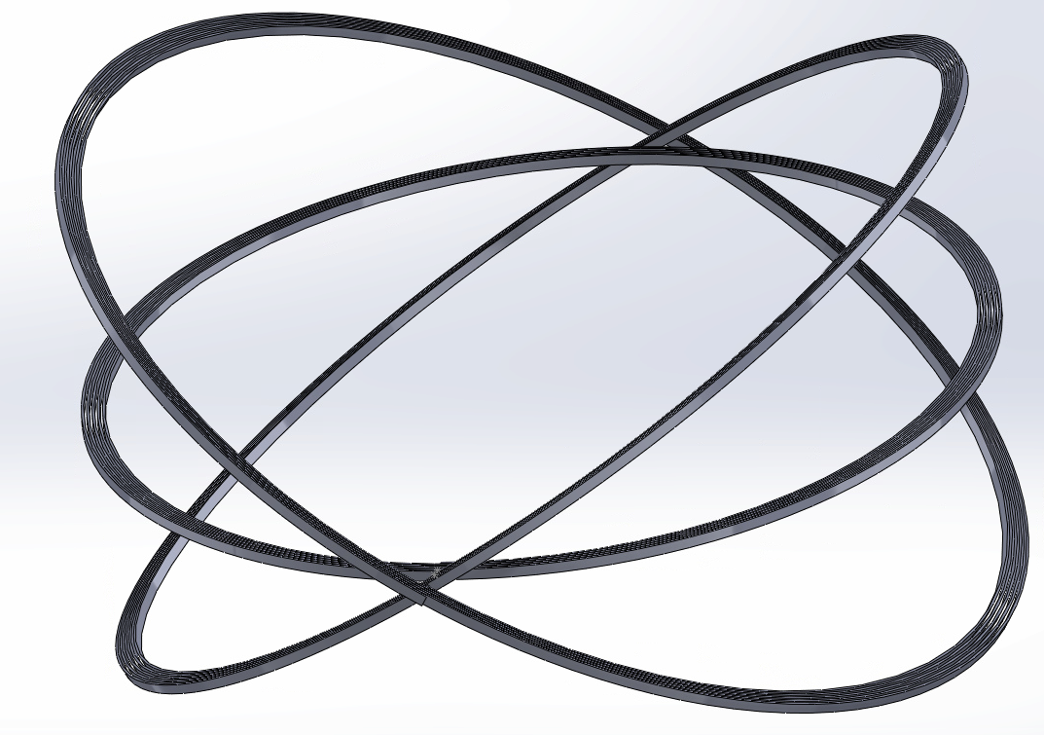
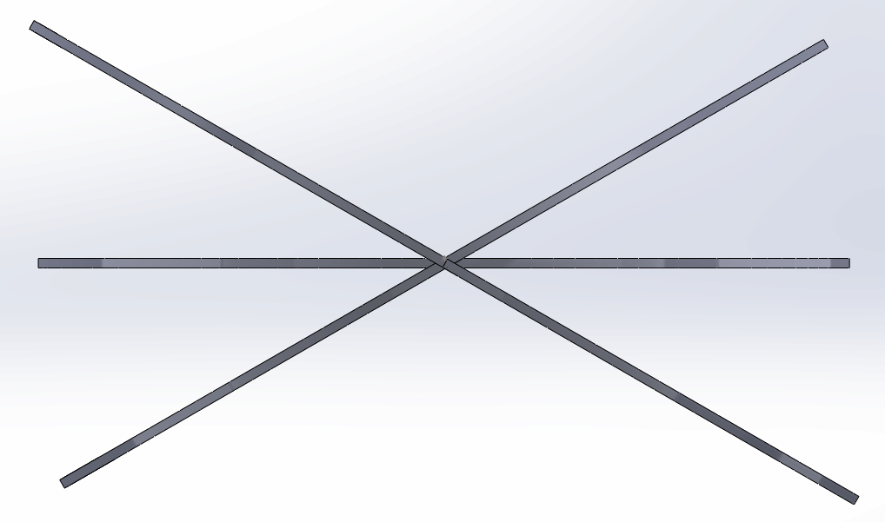
System Design-Coils

Slide 14
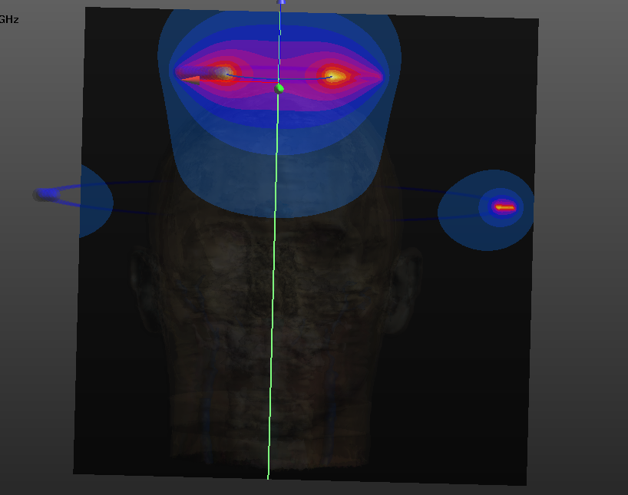
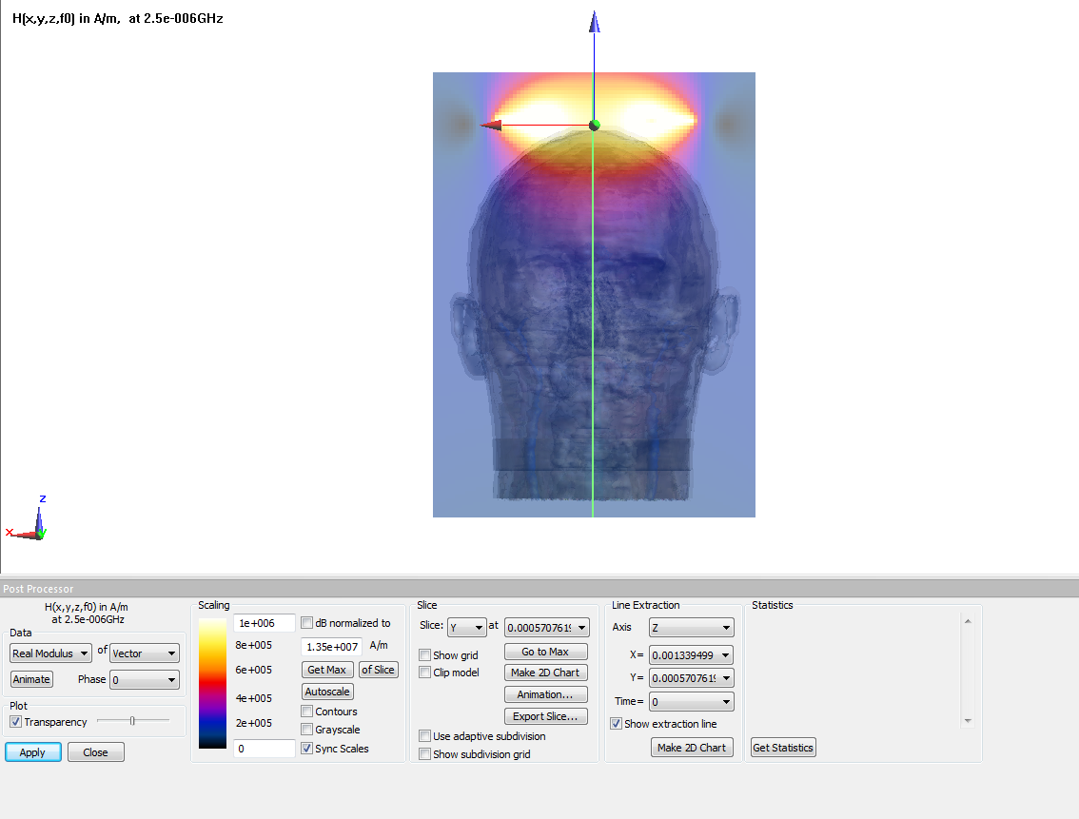
Magnetic Field Analysis - SemCADx
Standard Halo coil THC with 200 by 300

Slide 15
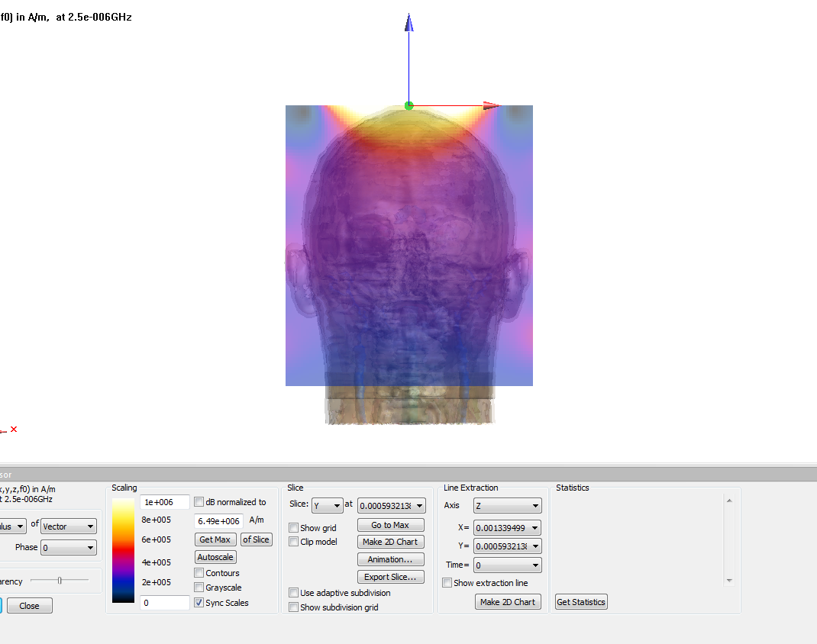
Magnetic Field Analysis - SemCADx
THC with 110 by 150 THC with 200 by 300

Slide 16
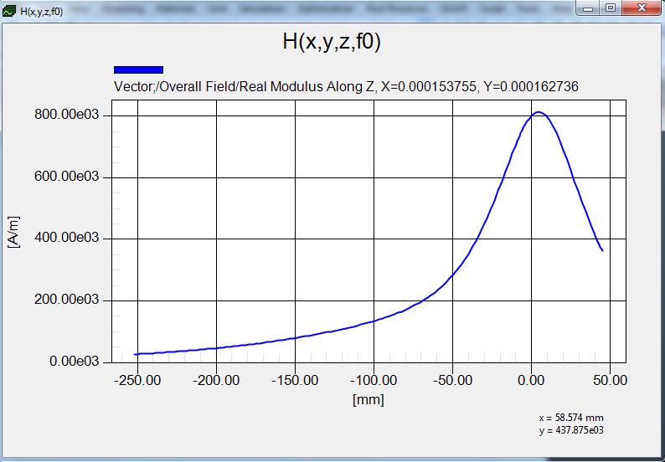
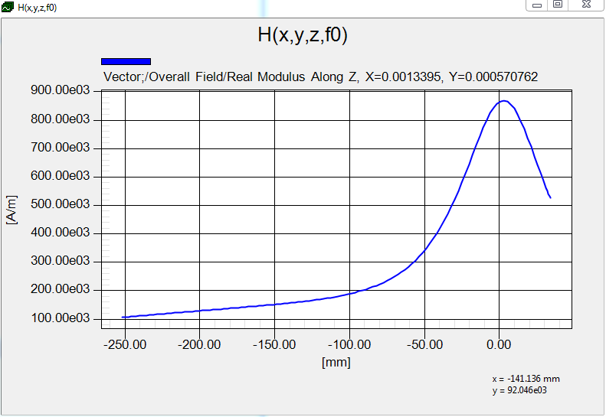
Test Plan
Standard Halo Coil
THC (200 by 300)

Slide 17
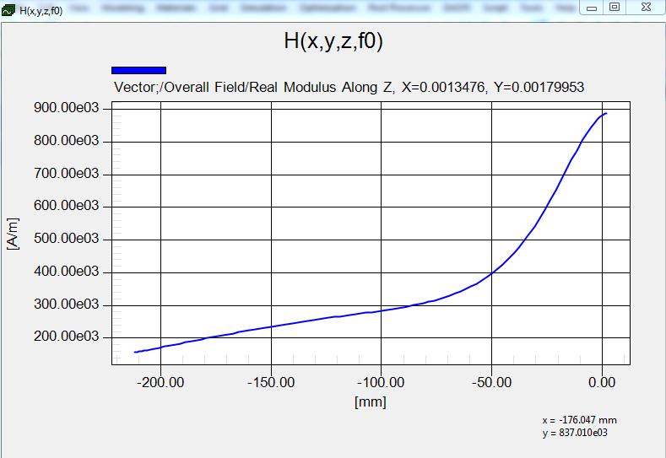
Test Plan
THC (110 by 150)
THC (200 by 300)

Slide 18
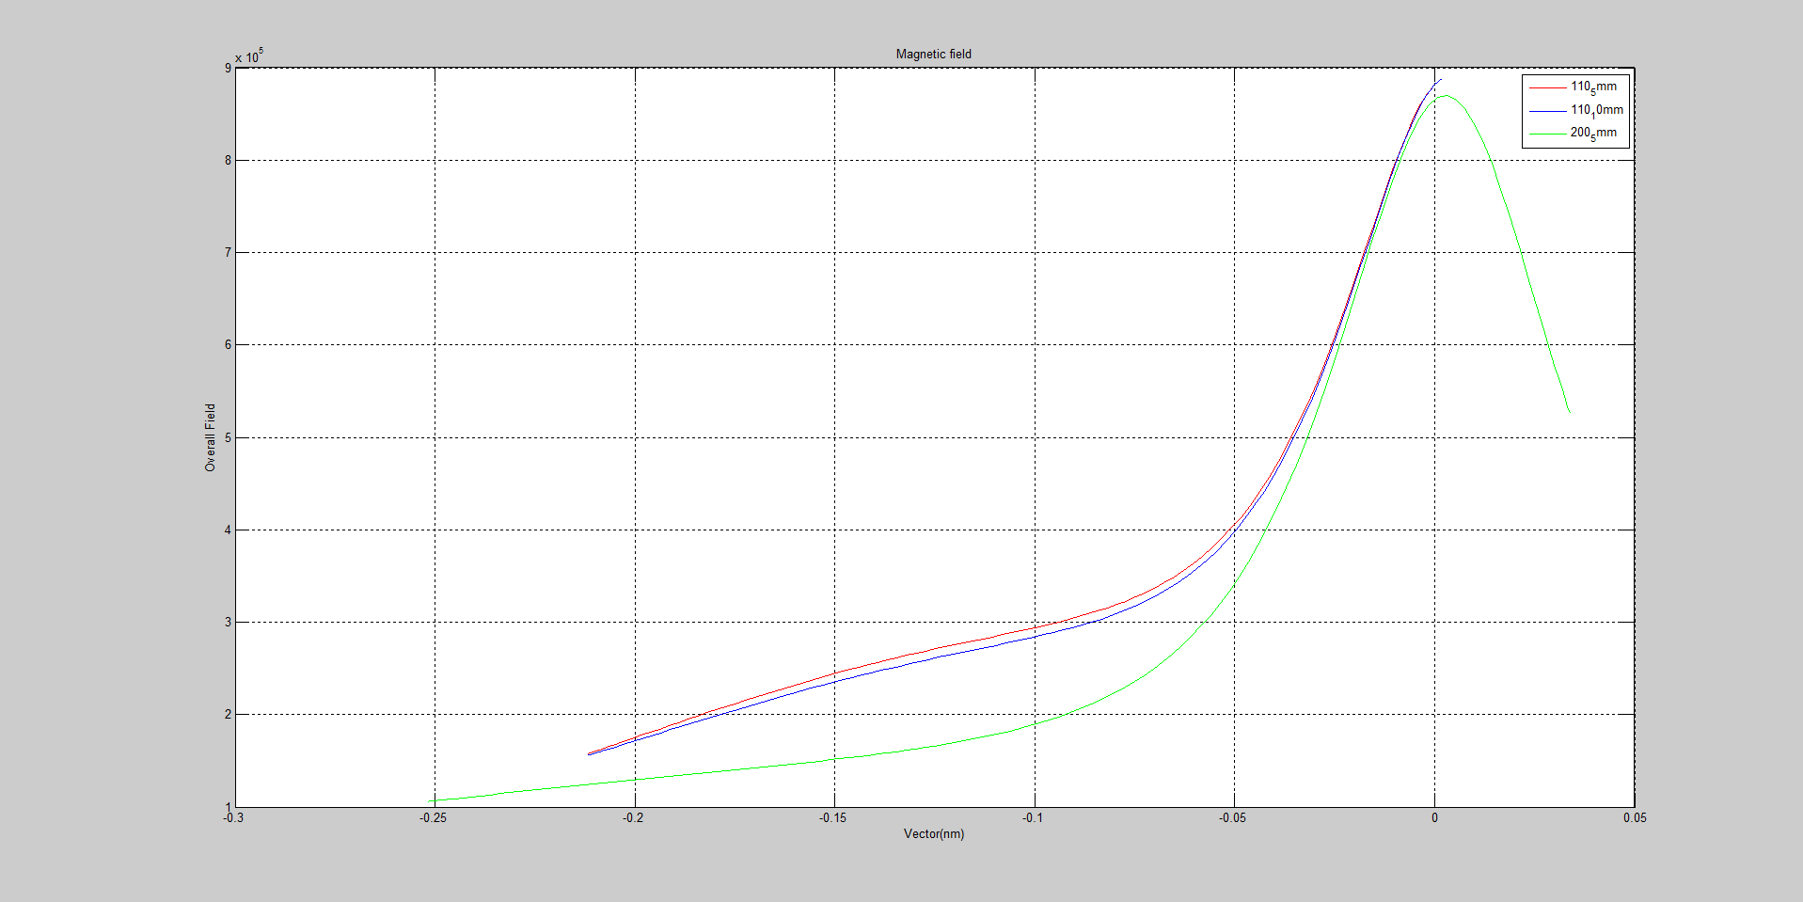
Test Plan Comparison

Slide 19
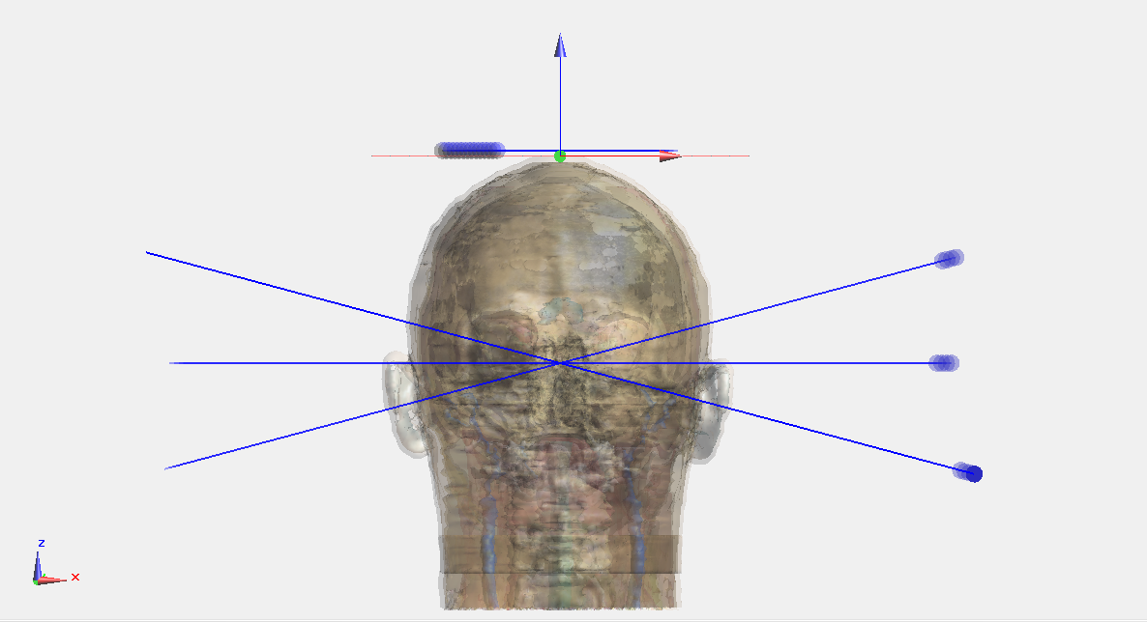
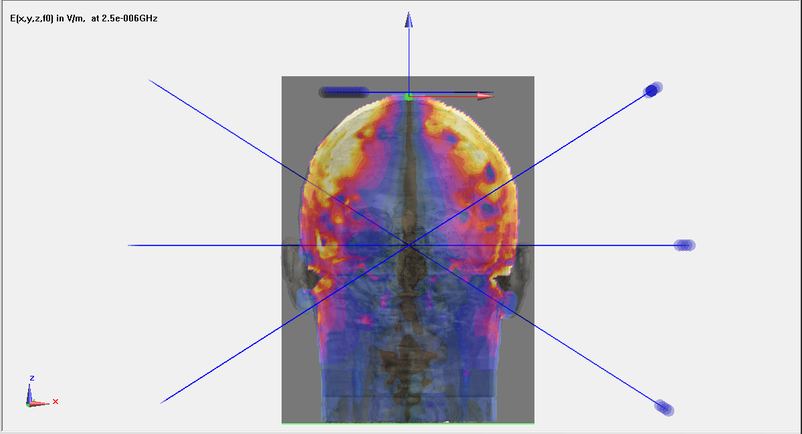
System Design-Coils
Rotate Angle
Electric field

Slide 20
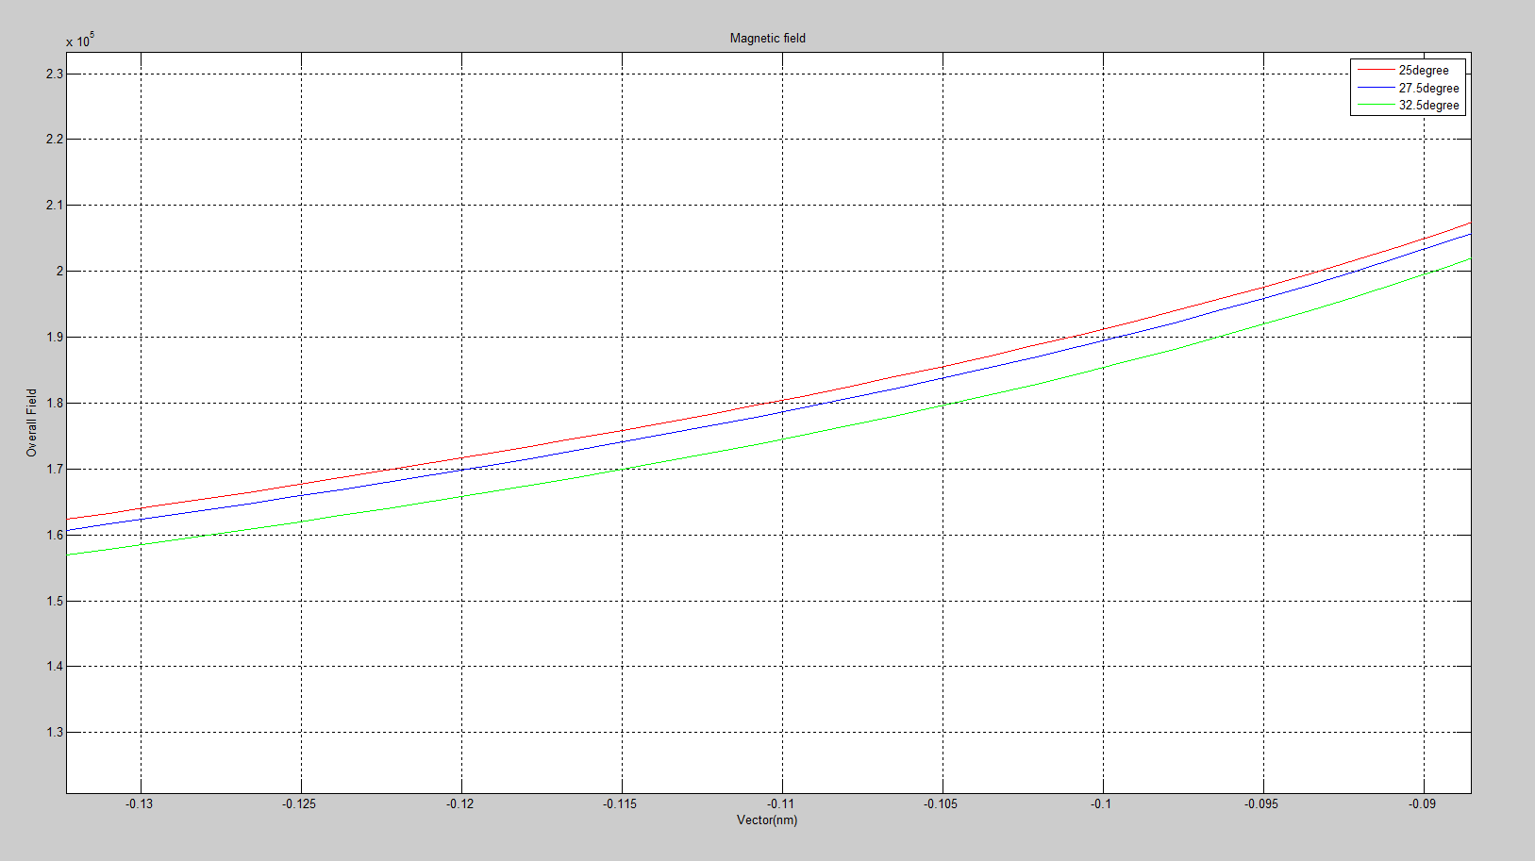
System Design-Coils
Change angle 25 degree, 27.5degree, 32.5degree

Slide 21
Current Project Status
Complete Project Plan and Design document
Comparing different coils

Slide 22
Task Responsibility
Aashwatth Agarwal - Team Leader, Key Concept Holder
SEMCAD simulations
Documentation
Dylan Jagger Rasmusson - Team Communication Leader, Key Concept Holder
COMSOL analysis
SolidWorks Design
Wentai Wang - Team Webmaster, Key Concept Holder
SEMCAD simulations (part of)
Coil configuration measurement
Document creation

Slide 23
Plan for next Semester
Fabricate Triple Halo Coil and Test

Slide 24
Q&A
Questions?

